Slide 1

testingPackageCpp.epc
Using F2I-CONSULTING Resqml2 API
08/22/2014 Schema
Contacts:
mathieu.poudret@geosiris.com
philippe.verney@f2i-consulting.com

Slide 2
Individual surfacic representations
2 horizons
Each with 2 triangulated patches
First horizon is also represented by a 2d grid (associated with two continuous properties) and a point set
1 normal fault, 2 different representations
Single triangulated patch
5 triangulated patches

Slide 3
Horizons and Fault 2D Graphical view
X
Z
250m
Z=300m
400m
Z=350m
Horizon1
Z=500m
Horizon2
450m
Z=550m
200m
Fault1
First patch of each horizon are on hanging wall side of the fault (left side on this illustration)
Second patch of each horizon are on footwall side of the fault (right side on this illustration)

Slide 4
Horizons and Fault 3D Graphical view
Screenshot results from Horizons and Faults
reading

Slide 5
Triangulated Horizons node indexing

Slide 6
Single Patch Triangulated Fault node indexing
0
1
2
200
300
3
5
4
350
6
7
8
Patch0
500
9
10
11
550
12
14
13
650
15
Z
16
17

Slide 7
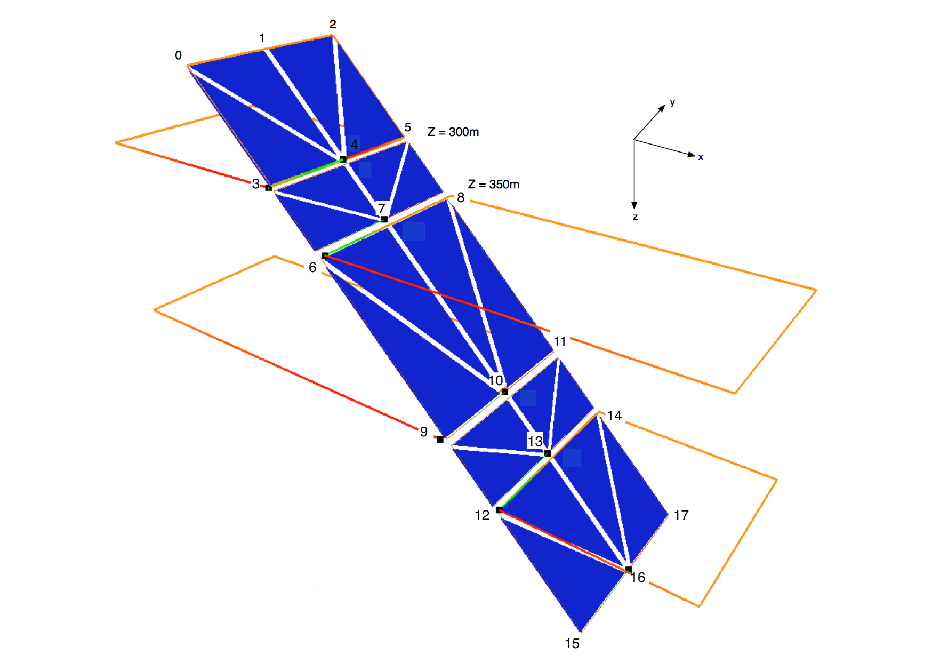
Single Patch Triangulated Fault node indexing

Slide 8
Multipatch Triangulated Fault node indexing
0
1
2
200
Patch0
300
3
4
5
6
7
8
9
10
11
Patch1
350
12
13
14
Patch2
15
16
17
500
18
19
20
21
22
23
Patch3
550
24
25
26
Patch4
650
27
29
Z
28

Slide 9
Multipatch Triangulated Fault node indexing

Slide 10
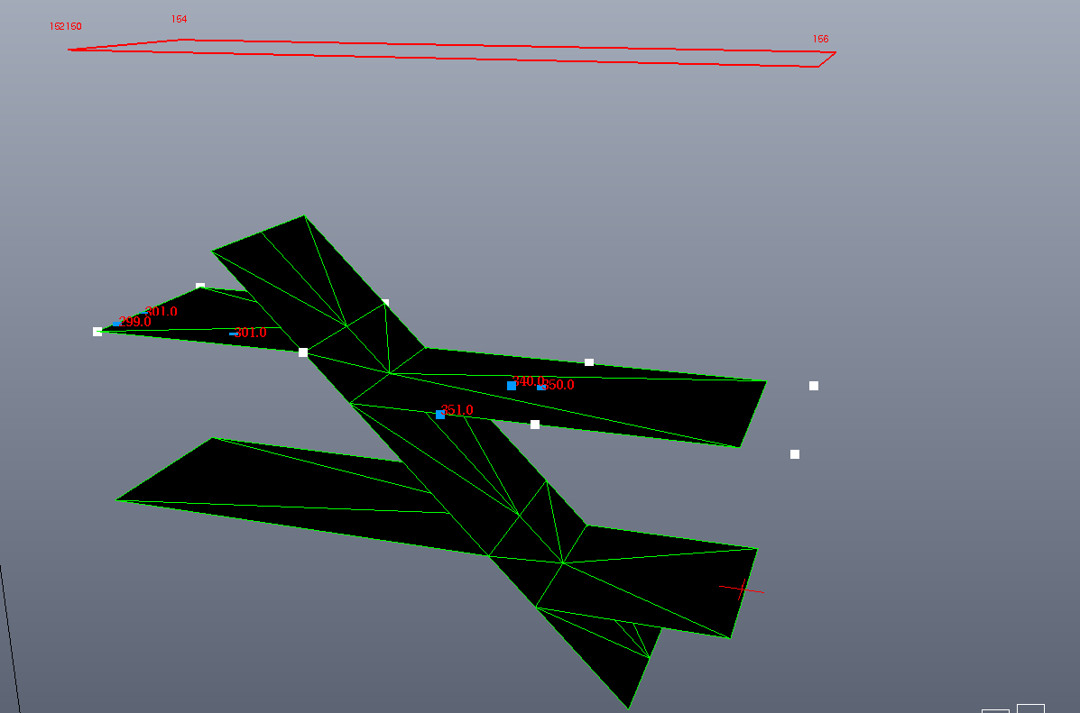
Screenshot
Red rectangle (top of the illustration) is the seismic lattice
Numbers are inlines (left to right) and crosslines (front to back)
Blank vertices are grid 2d nodes of the top horizon
Blue vertices are a point set representation of Top horizon with their Z values.

Slide 11
Sealed surface framework
2 sealed surface framework
1 according to single patch triangulated fault
1 according to 5 triangulated patches fault
4 contacts between horizon and fault
2 contact identity : previous colocation
Each contact is composed by 3 contact patches

Slide 12
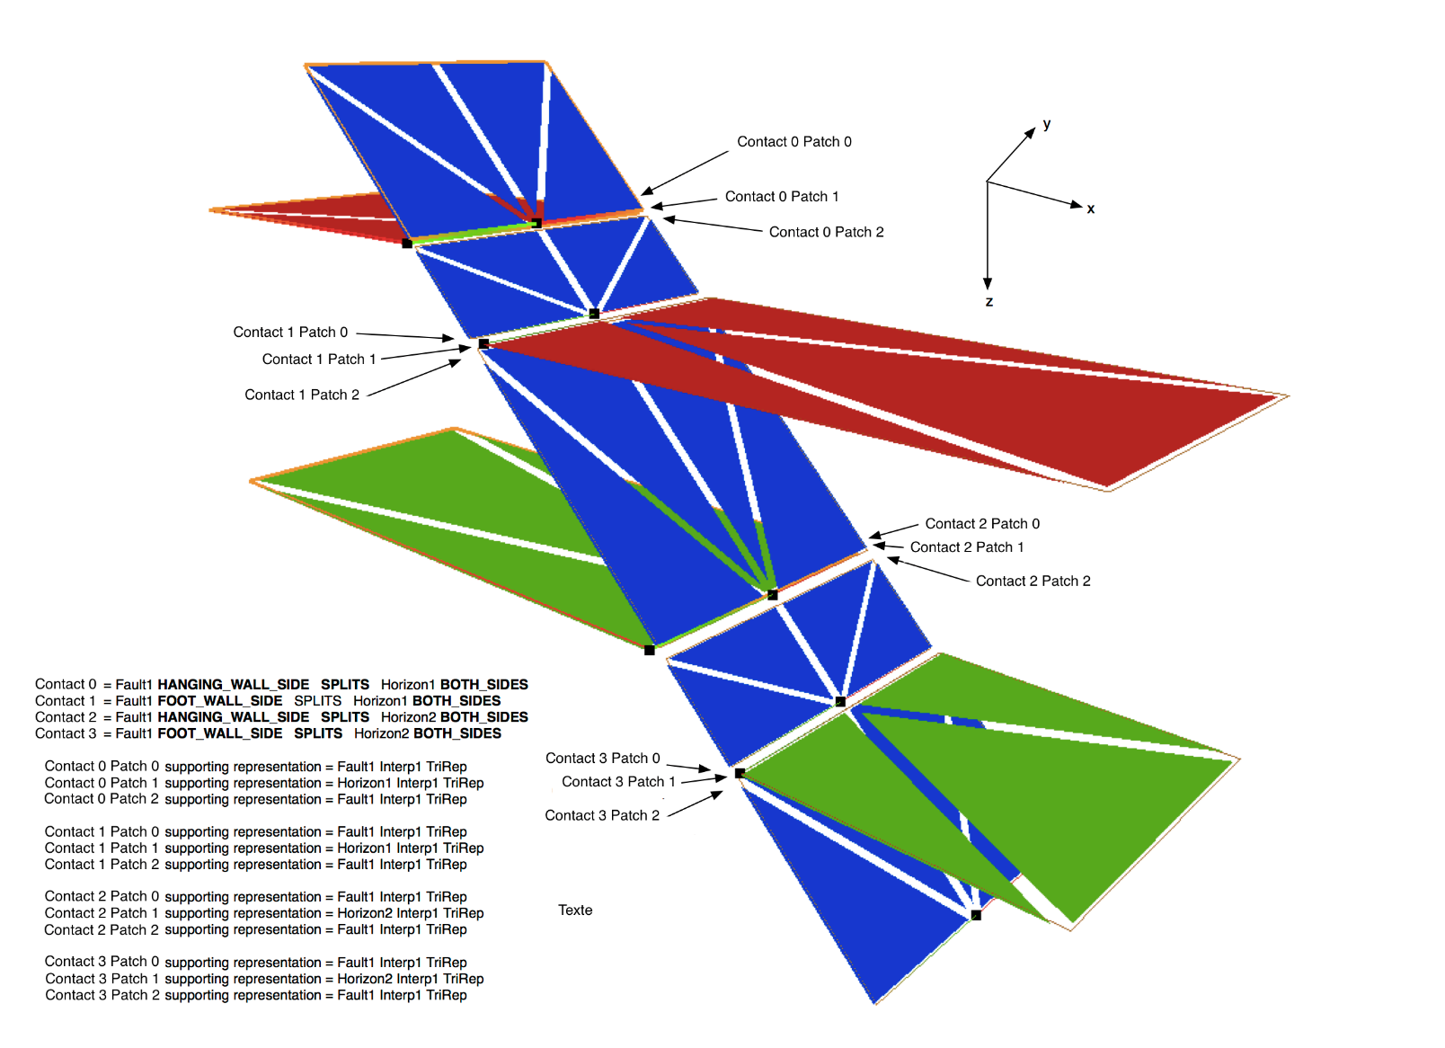
Contacts 3D Graphical view
PREVIOUS
COLOCATION
PREVIOUS
COLOCATION

Slide 13
IJK Grids
2 grids
A single cell one (obviously non splitted)
A two cell one (splitted)
With a discrete property indicating the cell index
Based on a local property type inheriting from « discrete » Energistics standard property type.

Slide 14
Single cell 2D Graphical view
X and I
Z
And
K
Z=300m
Z=350m
Z=500m
Z=550m

Slide 15
Two cells 2D Graphical view
X and I
Z
And
K
Z=300m
Z=350m
0
1
Z=500m
Z=550m
Cell index discrete property

